Slide 1
CUDA Class – Week 2
Grids, Blocks, and Threads

Slide 2
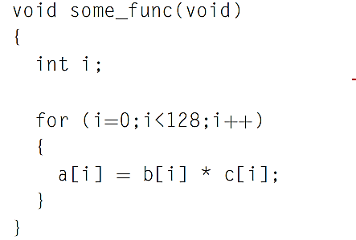
Recap: Threading on GPU
Let’s say we have 2 arrays and we want to multiply the values in the first array to those in the second one.
In typical C/C++ we would do something like this
Notes:
This piece of code is very simple. It stores the result of a multiplication of b and c value for a given
index in the result variable a for that same index. The for loop iterates 128 times (indexes 0 to 127).
In CUDA you could translate this to 128 threads, each of which executes the line.
a[i] = b[i] * c[i]
In CUDA, you translate this loop by creating a kernel function, which is a function that executes on
the GPU only and cannot be executed directly on the CPU.
In the CUDA programming model the CPU handles the serial code execution, which is where it excels. When you come to a computationally
intense section of code the CPU hands it over to the GPU to make use of the huge computational power
it has.

Slide 3
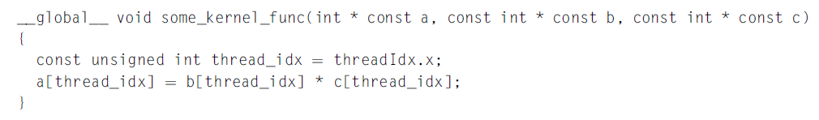
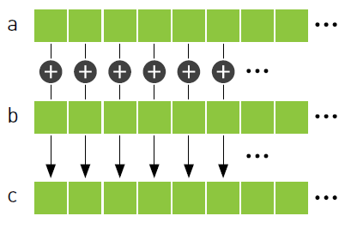
Recap: kernel
In CUDA you could translate this to 128 threads, each of which executes the line, and they would all run at the same time.
a[i] = b[i] * c[i]

Slide 4
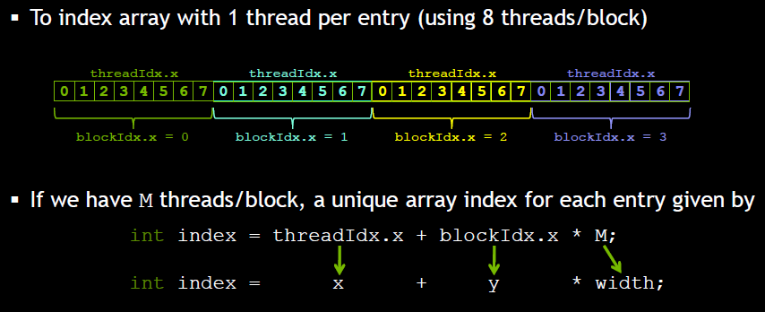
Recap: Indexing “threadIdx.x , blockIdx.x”

Slide 5
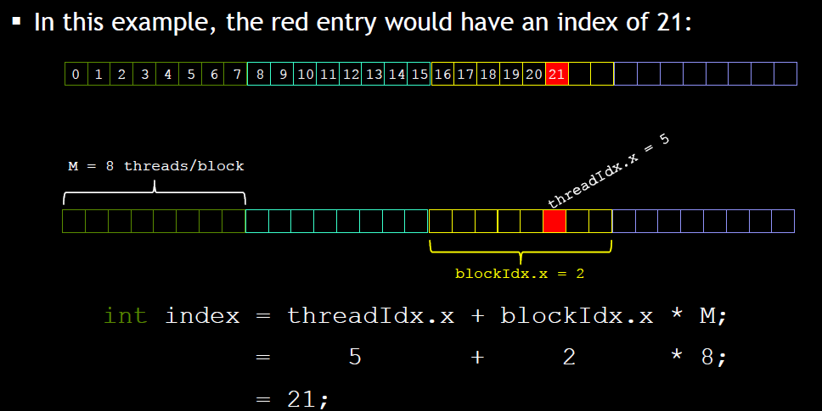
Recap: indexing example

Slide 6
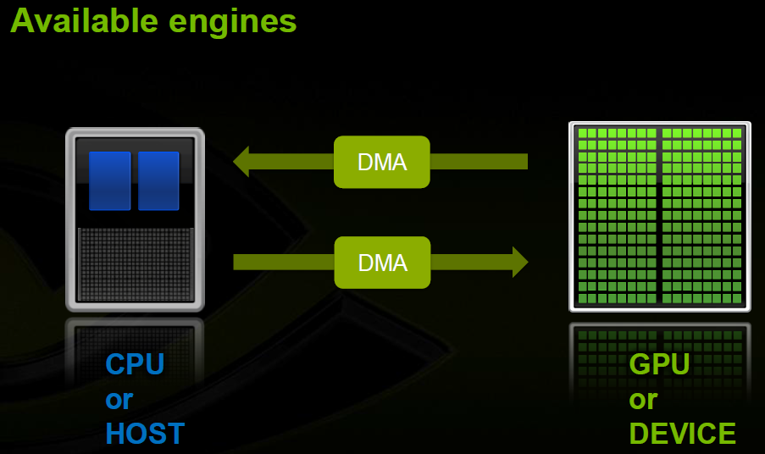
Recap: CUDA Execution model

Slide 7
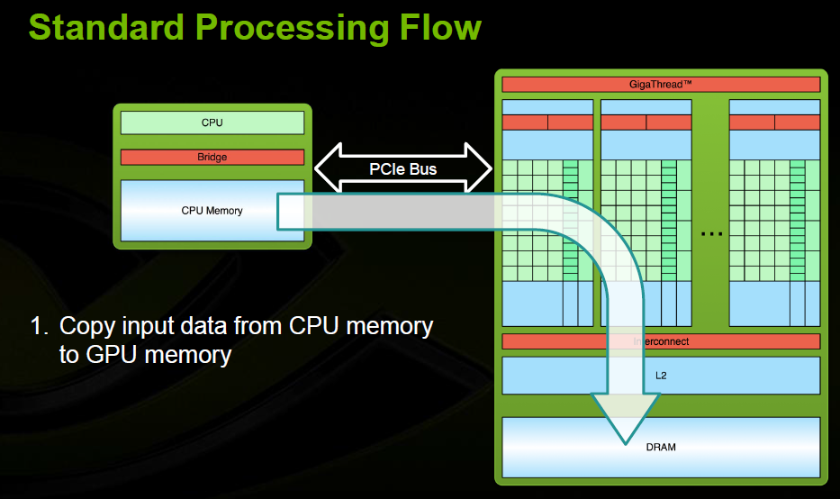

Slide 8
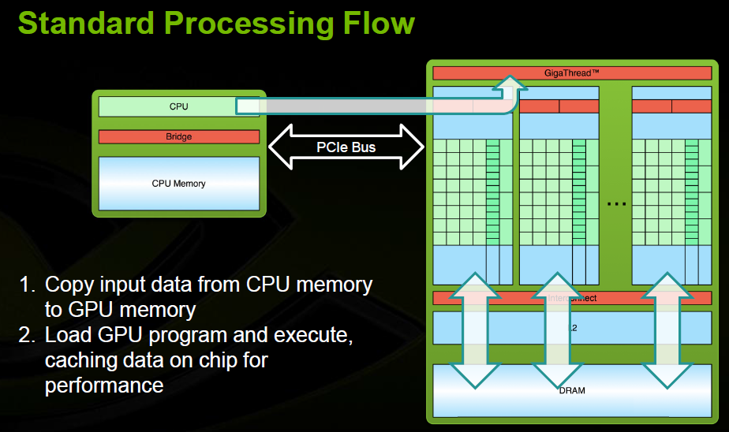

Slide 9
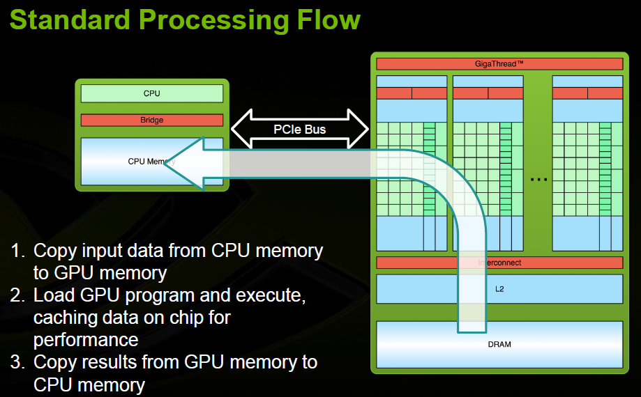

Slide 10
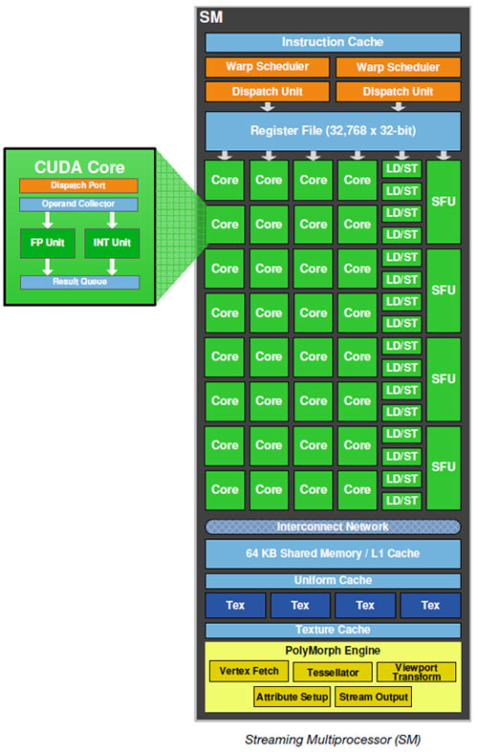
Threads, Blocks, and Grids
Grid → GPU: An entire grid is handled by a single GPU chip.
Block → SM (some use MP): The GPU chip is organized as a collection of Symmetric Multiprocessors (SMs), with each multiprocessor responsible for handling one or more blocks in a grid. A block is never divided across multiple MPs.
Thread → SP: Each SM is further divided into a number of stream processors (SPs), with each SP handling one or more threads in a block.

Slide 11
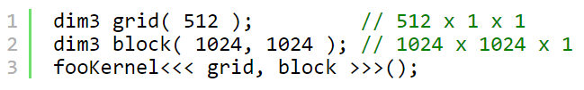

dim3 data type
dim3 is an integer vector type that can be used in CUDA code. Its most common application is to pass the grid and block dimensions in a kernel invocation. It can also be used in any user code for holding values of 3 dimensions.
Defined as structure in vector_types.h
It cannot be used directly in any arithmetic operations ( grid + block ) or in any sort of vector swizzling ( grid.xyz = block.zyx ). :-(
Notes:
In computer graphics, swizzling means rearranging the elements of a vector. For example, if A = {1,2,3,4}, where the components are x, y, z, and w respectively, you could compute B = A.wwxy, whereupon B would equal {4,4,1,2}. This is common in GPGPU application.
Source: Wikipedia.org

Slide 12


Some Maximums
You can launch up to 1024 thread per block. primarily imposed by the small number of registers that can be allocated across all the threads running in all the blocks assigned to an SM.
My GeForce GT 635M can launch 1024x65535 = 67,108,864 threads without a hiccup.

Slide 13
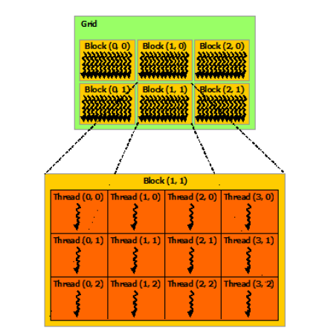
Why blocks ?
You may be wondering why not just say “launch 67 million threads” instead of organizing them into blocks.
Each GPU has a limit on the number of threads per block but (almost) no limit on the number of blocks. Each GPU can run some number of blocks concurrently, executing some number of threads simultaneously.
By adding the extra level of abstraction, higher performance GPU's can simply run more blocks concurrently and chew through the workload quicker with absolutely no change to the code!
nVidia has done this to allow automatic performance gains when your code is run on higher performance GPU's.

Slide 14
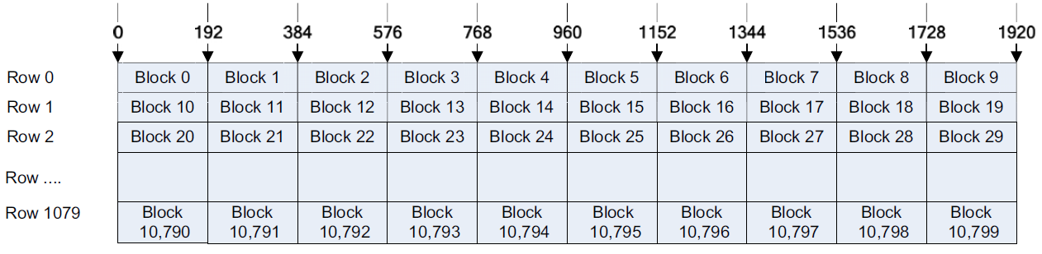
Grids
A grid is simply a set of blocks where you have an X and a Y axis, in effect a 2D mapping.
The number of threads in a block should always be a multiple of the warp size, which is currently defined as 32.
EX:
HD image, you have a 1920 1080 resolution
1080 rows of 10 blocks, you have in total 1080x10 = 10,800 blocks.
About 1920x1080x10 = 2,073,600 threads
Notes:
Along the top on the X axis, you have the thread index.
The row index forms the Y axis. The height of the
Row is exactly one pixel. As you have 1080 rows of 10 blocks, you have in total 1080x10 = 10,800 blocks.
As each block has 192 threads, you are scheduling just over two million threads, one for each pixel.

Slide 15
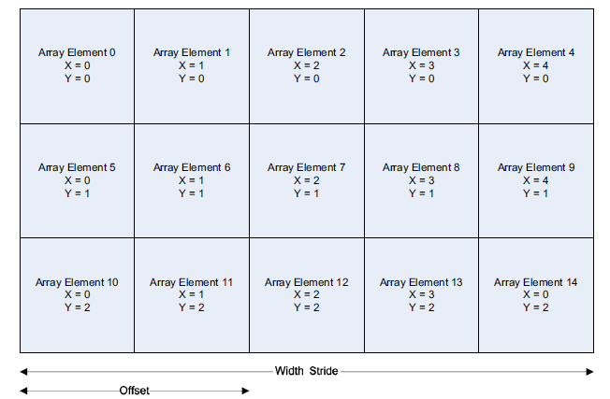
Stride and offset
This is all very well, but what if your data is not row based? As with arrays, you are not limited to a single dimension. You can have a 2D thread block arrangement. (8 x 8 blocks of pixels)
Your data need not be pixel based.
Stride of memory is the width of the array.
Offset is the column value being accessed, starting
at the left, which is always element 0.
Notes:
However, for 2D thread blocks, we need to introduce some new concepts. Just like in array indexing, to index into a Y element of 2D array, you need to know the width of the array, the number of X elements.

Slide 16
warps
Between the memory sizes and the thread/block/grid dimensions is the warp size
The warp size is the number of threads running concurrently on an SM.
Once a block is assigned to an SM, it is divided into units called warps.
The number of threads in a block should always be a multiple of the warp size, which is currently defined as 32.
keep the threads as homogenous as possible.
Notes:
The homogeneity of the threads in a warp has a big effect on the computational throughput. If all the threads are executing the same instruction, then all the SPs in an MP can execute the same instruction in parallel. But if one or more threads in a warp is executing a different instruction from the others, then the warp has to be partitioned into groups of threads based on the instructions being executed, after which the groups are executed one after the other. This serialization reduces the throughput as the threads become more and more divergent and split into smaller and smaller groups. So it pays to keep the threads as homogenous as possible.

Slide 17
2D kernel (X and Y thread indexes)

Slide 18
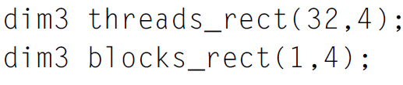
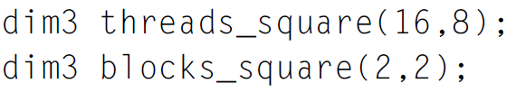
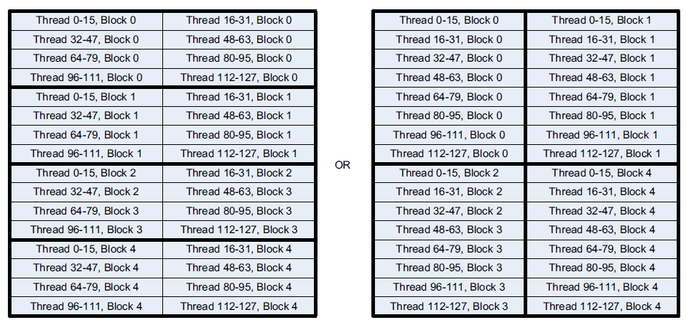

Slide 19
